Slide 1


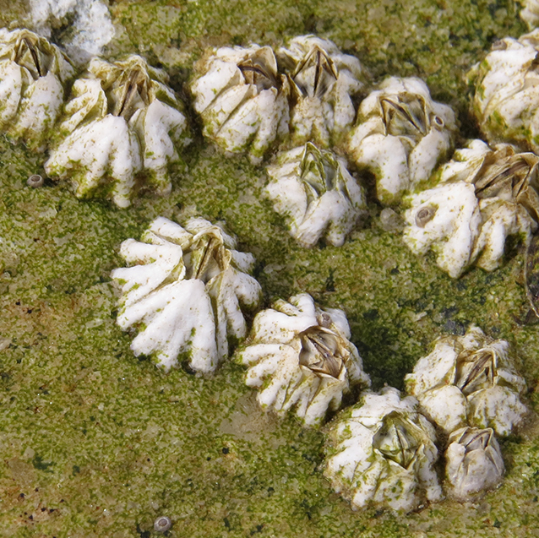
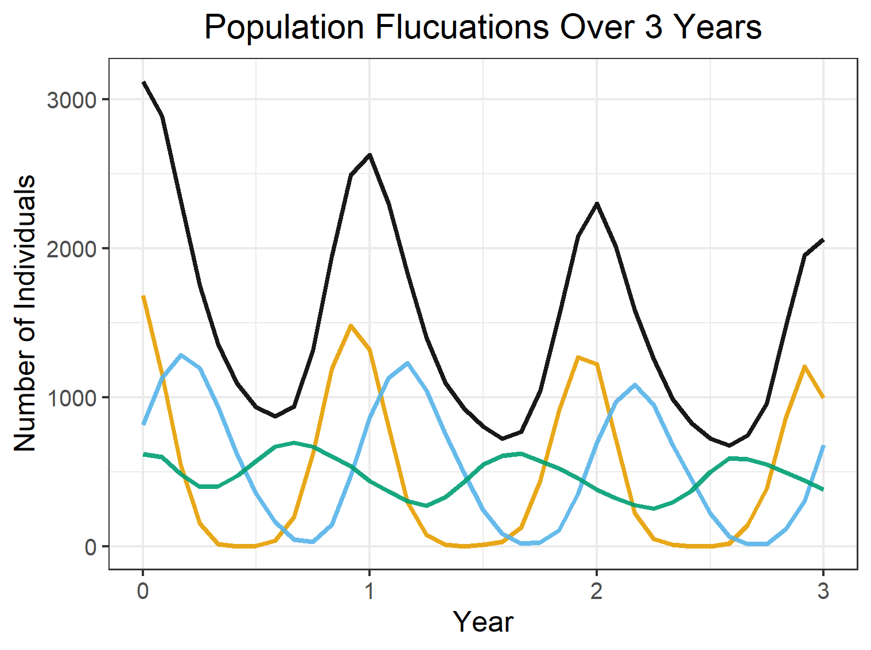
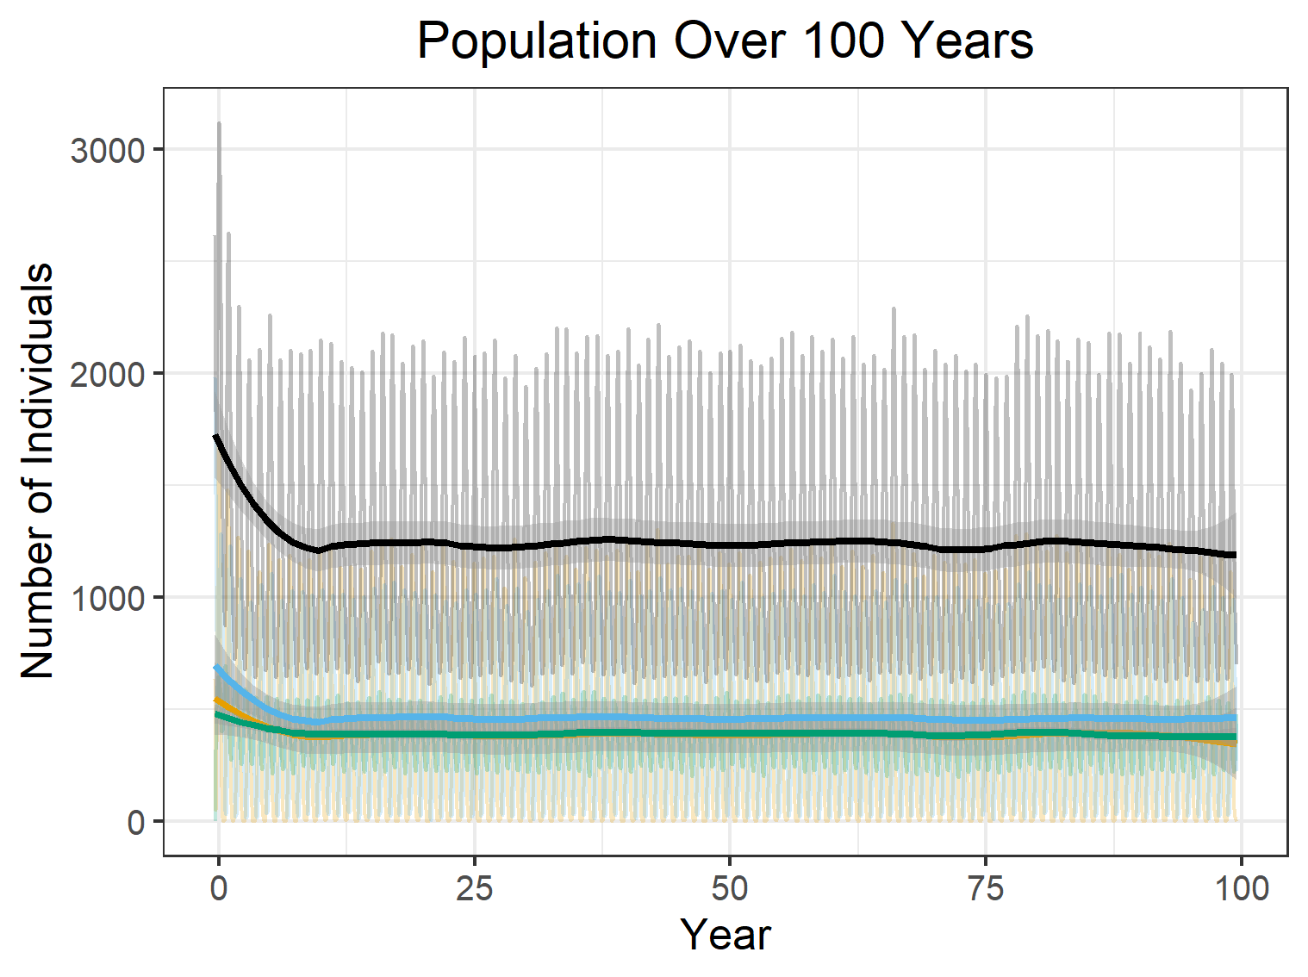
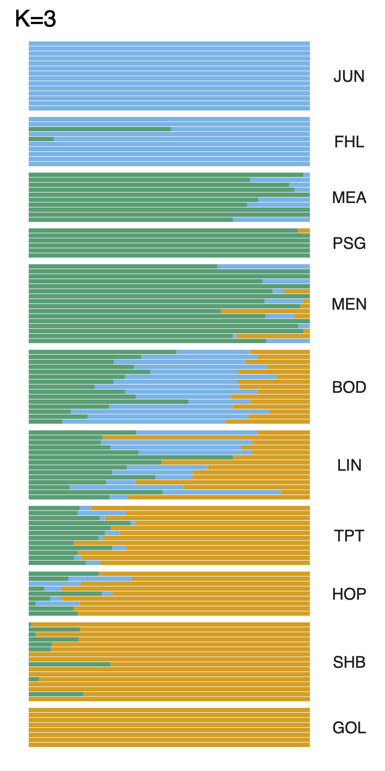
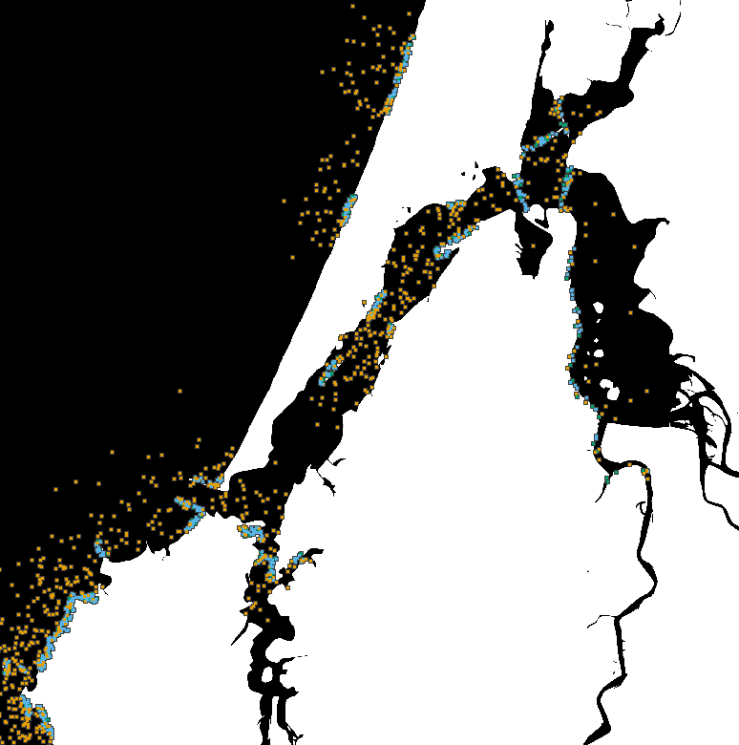
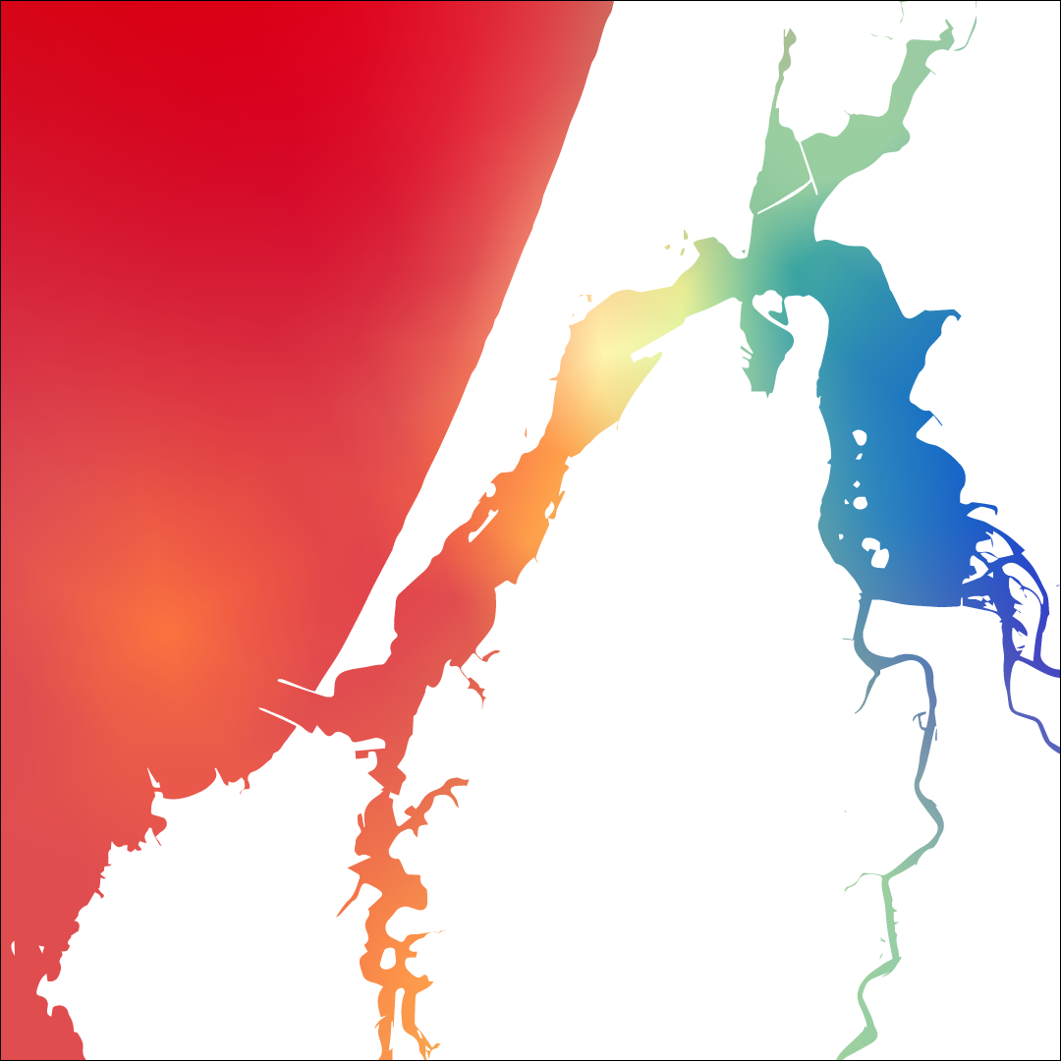
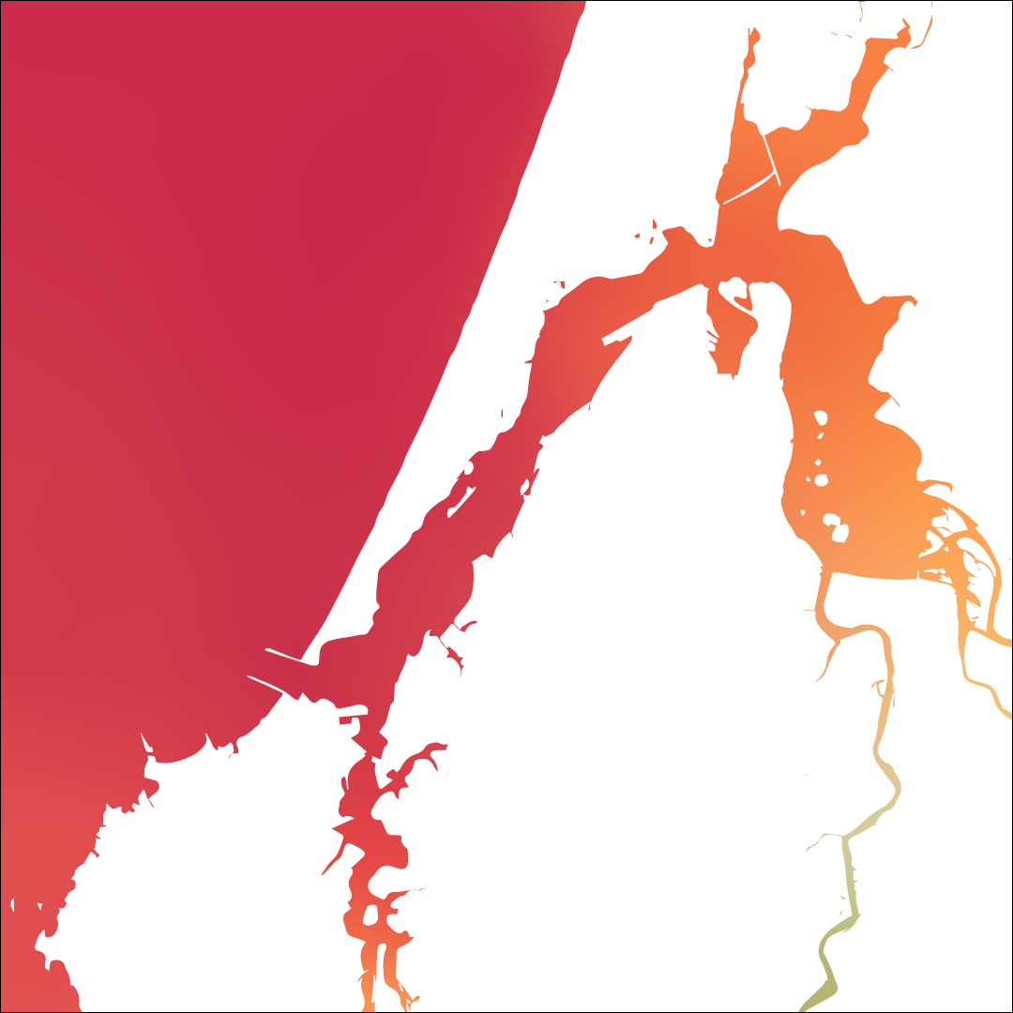
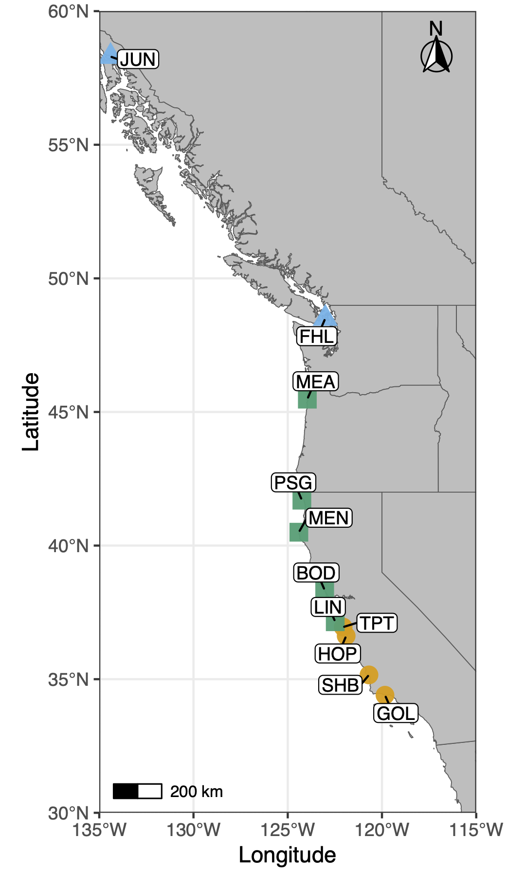
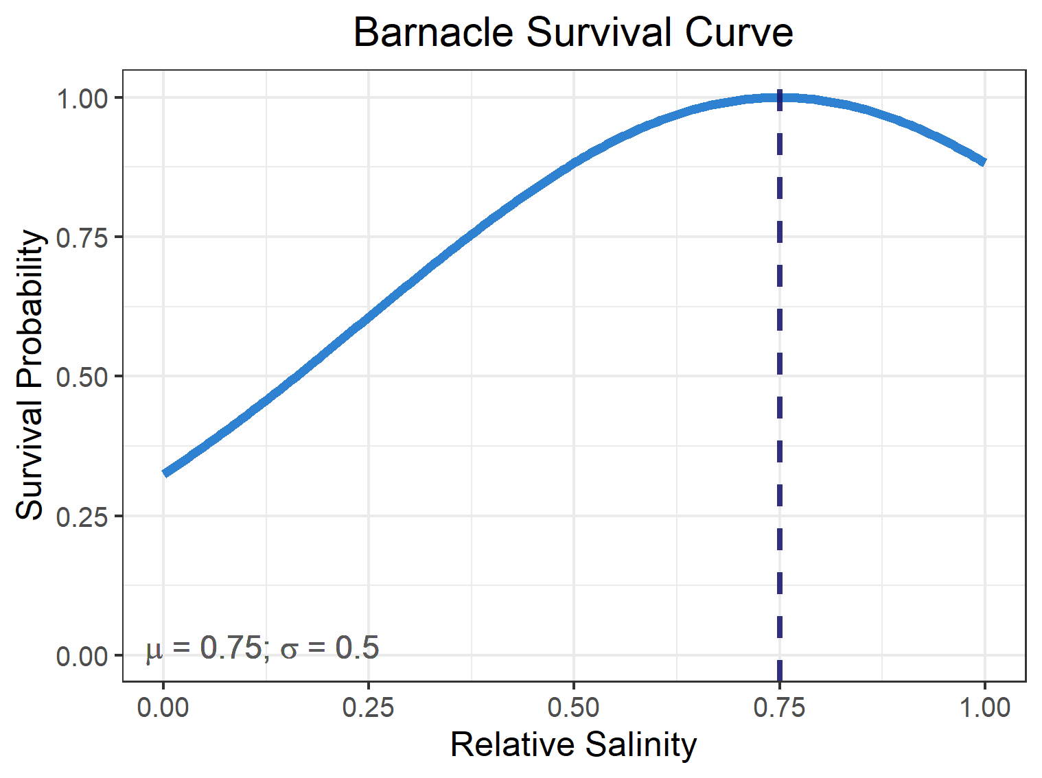
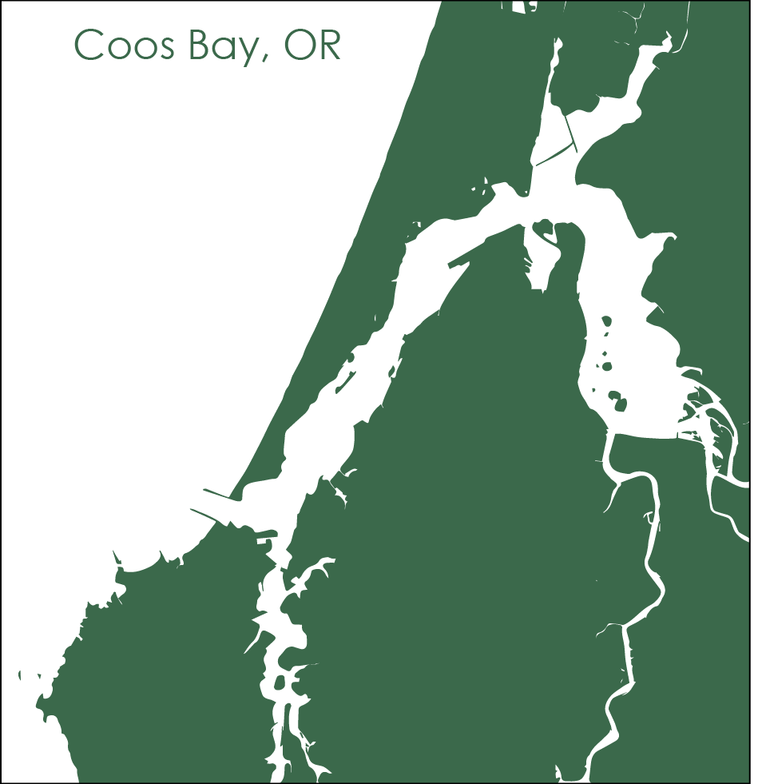
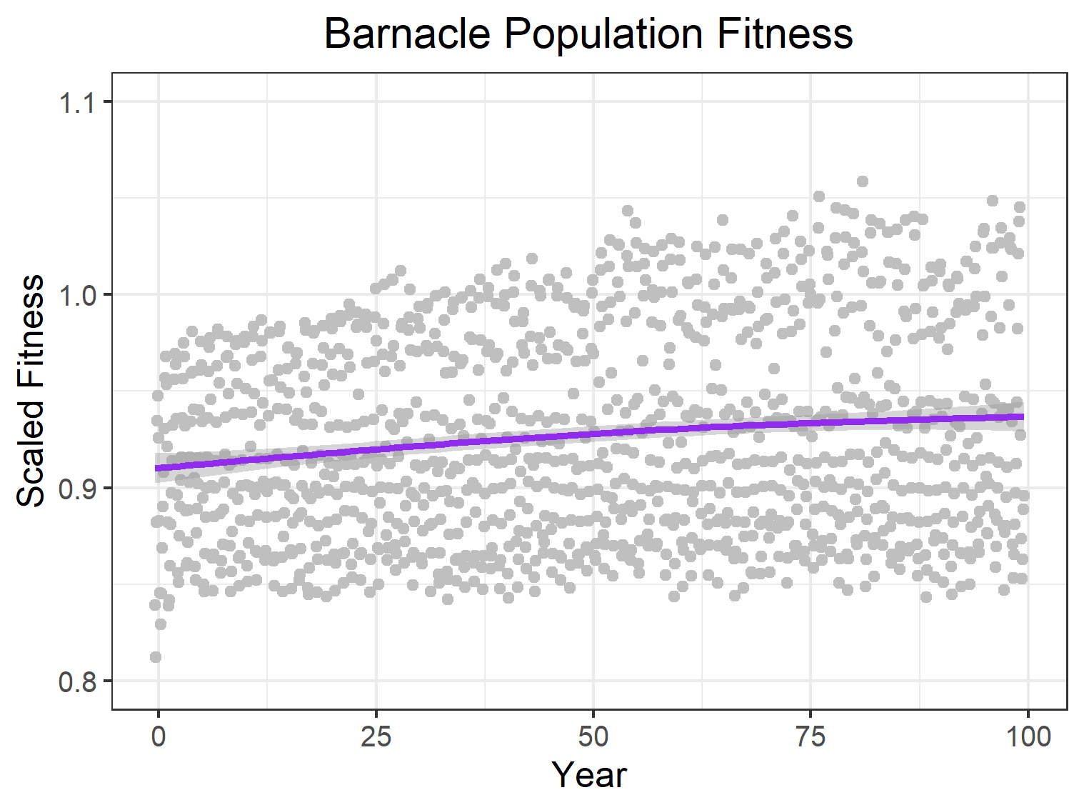
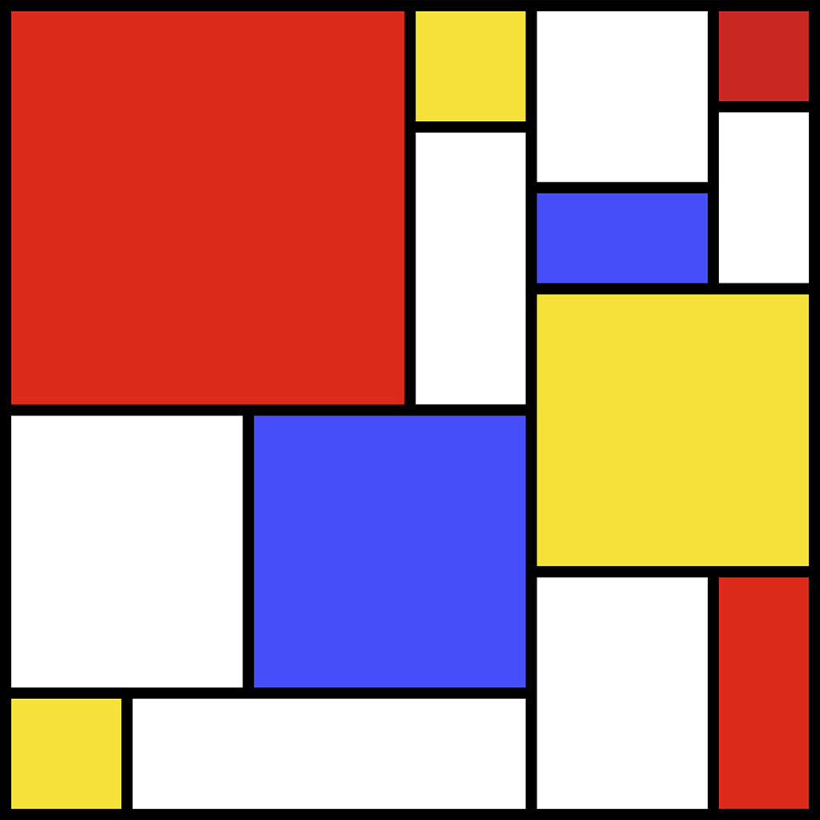

Mar del Plata, Provincia de Buenos Aires, Argentina
What a Load of Barnacles:
A Spatial Population Genomic Simulation Measuring Evolution at Large Scales
Alexandra Bangs¹, Angel Rivera-Colón¹, Jiseon Min¹, Peter Ralph^{1,2}
¹ Institute of Ecology and Evolution, University of Oregon, Eugene, Oregon, USA, ²Department of Mathematics, University of Oregon, Eugene, Oregon, USA
Background
How do we model population genomics for the Pacific acorn barnacle (Balanus glandula)?
Conclusion
Expand the library of biological simulations
Science is a collaborative process, and constructing new simulations involves building off previous work
The variables and scenarios we’ve modeled can be adapted to other biological systems and contribute to our understanding of species otherwise unrelated to the Pacific acorn barnacle.
The Pacific acorn barnacle
Filter-feeding invertebrate found in intertidal zones
Undergoes planktonic larval stage, and sessile juveniles and adult stages
Our model captures the life cycle and reproduction of the Pacific acorn barnacle
Implemented a population response to environmental variables
Developed a framework for future research on this biological system
Reproduction and life stages
Brooding occurs seasonally in the late winter, with larvae dispersing during the summer and juveniles settling in the fall
Barnacle Life Stages
— Larvae | — Juveniles | — Adults | — Total
Future Steps
© Martin Arregui
1
Expanding Environmental Model
Implementing other environmental conditions that impact barnacles such as temperature and tides⁷
Add seasonal variation of environmental variables
Model long-term environmental change
The Pacific Coast Range
We observe population structure across the Pacific Coast²
The Effects of Environmental Variables
Juvenile (recently settled) barnacles have higher survival at moderate to high salinities^{4,5}
Temperature Model, Winter 2014⁵
Temperature Model, Summer 2014⁵
Evolution of Barnacle Populations
Apply model to study the genomic variation of barnacle populations across the Pacific coast
What environmental variables are contributing to the population structure?
SLiM simulation of Coos Bay, OR
SLiM is an evolutionary simulation framework³
It allows us to simulate individuals, their genomes, and the spatial interactions between the population and their environment
Acknowledgments
Thank you to Erin Jesuit of the VonDassow Lab at OIMB for your help collecting and analyzing B. glandula samples.
To Dave Sutherland for providing environmental models of Coos Bay, OR.
To the Kern Ralph Co-Lab for being a wonderful group to collaborate and learn with.
To Ben Haller and Philipp Messer for the development of SLiM: An Evolutionary Simulation Framework.
To the University of Oregon Summer Program for Undergraduate Research and the Mary G. Alden Fellowship for the funding to pursue summer research.
And to ASM for providing a travel award to attend ABRCMS 2024
Modeling Population Fitness
Fitness is the product of density-dependent selection⁷, environmental gradients, and local adaptation
To see the effects of local adaptation, the model needs to run for much longer than 100 years!
References
Scan the QR code to see this project’s GitHub repository!
iNaturalist community. Observations of Balanus glandula from Mar del Plata, Provincia de Buenos Aires, Argentina observed on Nov 6, 2021. Exported from https://www.inaturalist.org on 11/6/2024
Wares, J. P., Strand, A. E. & Sotka, E. E. Diversity, divergence and density: How habitat and hybrid zone dynamics maintain a genomic cline in an intertidal barnacle. Journal of Biogeography 48, 2174–2185 (2021).
Haller, B. C. & Messer, P. W. SLiM 4: Multispecies Eco-Evolutionary Modeling. The American Naturalist 201, E127–E139 (2023).
Berger, M. S., Darrah, A. J. & Emlet, R. B. Spatial and temporal variability of early post-settlement survivorship and growth in the barnacle Balanus glandula along an estuarine gradient. Journal of Experimental Marine Biology and Ecology 336, 74–87 (2006).
Conroy, T., Sutherland, D. A. & Ralston, D. K. Estuarine Exchange Flow Variability in a Seasonal, Segmented Estuary. Journal of Physical Oceanography, 50(3), 595-613 50, 595–613 (2020).
Chevy, E. T. et al. Population genetics meets ecology: a guide to individual-based simulations in continuous landscapes. Preprint at bioRxiv (2024).
Berger, M. Reproduction of the intertidal barnacle Balanus glandula along an estuarine gradient. Marine Ecology 30, 346–353 (2009).
Notes:
Judges are looking for
Title, Authors and Institutional Affiliation, Hypothesis/Objective, Background, Methods, Results, Conclusions, Future Work, Bibliography, and Acknowledgments
Top Section: Title, Authors, and Institutional Affiliation
Left Section: Background, Methods (QR code to barnacle sim repository)
Background:
Line about what the Kern-Ralph Co-Lab does
Line about Wares’ work studying the Pacific coast cline
Line about what I have been doing within the Lab
Then what are the barnacles and where are they found
How are we modeling (SLiM)
Mention here’s a QR code to the GitHub repository if anyone wants to look at the nitty-gritty of our work.
Middle Section: Objective, Methods, Results
Objective: Develop model of the Pacific acorn barnacle and biologically-relevant environmental variables that isn’t computationally-expensive
What do we need to implement to accurately model B. glandula
Reproduction and Dispersal based on observations in the area
What biologically-relevant environmental variables do we need to find data for and implement?
Salinity and Temperature
What success have we seen so far?
Modeling variations in reproductive window
Implementing local adaptation
Reproduction
Sexual reproduction with neighbors, producing multiple broods a year
Seasonal brooding occurs in the late winter with larval dispersal occurring after ~4 months, during the summer
Impact of Salinity and Temperature
Current literature suggests juvenile (recently settled) barnacles do best at moderate salinities.
Adult barnacles have higher percent brooding (and thus increased offspring) at lower water temperatures.
Modeling Local Adaptation
B. glandula has limited dispersal capabilities, so populations see greater genomic divergence as the distance between them increases
Right Section: Conclusions, Future Work, Acknowledgements, Bibliography
Conclusion
We’ve successfully modeled the life cycle and reproduction methods of B. glandula
We’ve modeled the effects of biologically-relevant environmental variables on fitness
Developed the platform to conduct research on B. glandula in estuarine settings
Future Work:
Expanding the scope
We can now observe the genomic cline across Pacific acorn barnacle populations
Our future work will involve applying this simulation to other Pacific coast populations to examine the cause of this cline
Examine Climate Change Impacts
Ocean acidification impacts carapace growth
Impacted by changing temperature and Salinity
Very numerous and widespread, good model organism for studying adaptation to changing environments
Acknowledgements:
Thanks to Erin Jesuit at the Oregon Institute for Marine Biology,
Dave Sutherland of the Oceans & Ice Lab
Ben Haller and Philipp Messer for developing SLiM
And the University of Oregon Summer Program for Undergraduate Research and the Mary G. Alden Fellowship for research funding

